Slide 1
#907 Connector Checks

Slide 2
Truck Doesn’t Run
First: Ensure the battery has been charged overnight for a full 8-12 hours.
Next: Check charger function. Light should be green when connected to outlet alone and then turn red when connected to the product and charging.

Slide 3
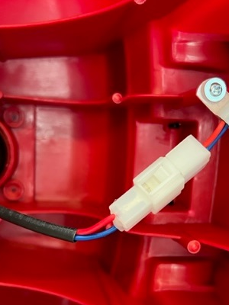
Connector Check A: Battery/Steering Wheel
Flip the truck on its side so you can view the underside.
Look for the long wire that comes from the back (battery) of the truck to the front (steering wheel).
Connection should be secure.

Slide 4
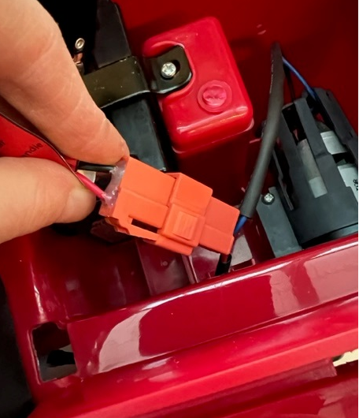
Motor/Battery Check
Next, remove the seat and check that the battery is connected and fully seated to the motor (red connectors).

Slide 5
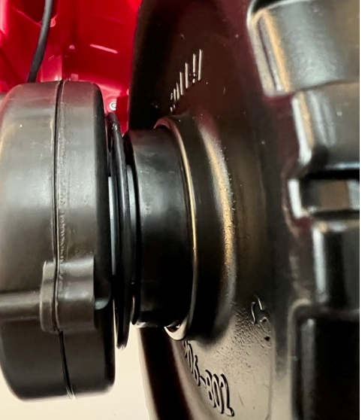
Motor Doesn’t Engage With Wheel
If you can hear the motor sound but it doesn’t engage with the wheel: check to ensure the motor is sitting flush against the wheel and it is stable (not wobbling) on the axle.

